Slide 1
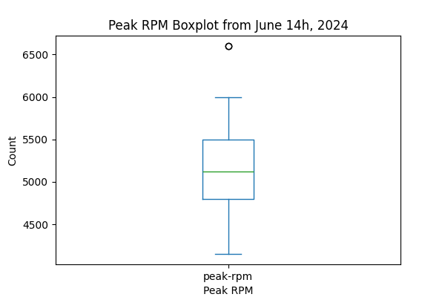
Slide #1: Peak RPM Boxplot Slide

Slide 2
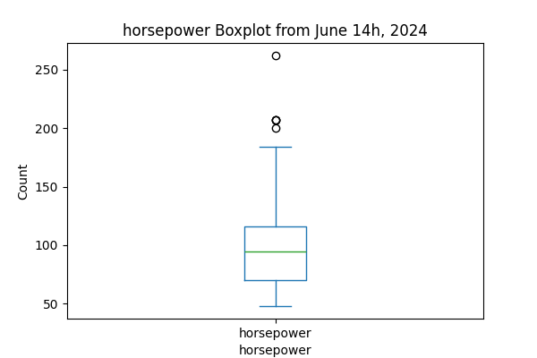
Slide #2: "Horsepower Box Plot"

